Slide 1

UNIVERSITY PROJECT – 2 HYRE – Higher You Reach Every time Group - 08

Slide 2

A PROJECT BY
Mr. Prajwal M S – 20171CSE0519
Mr. Prajwal P – 20171CSE0520
Mr. Pramukh N S – 20171CSE0524
Ms. Priyanka A – 20171CSE0536
Ms. Rachna Shah – 20171CSE0551
Under the guidance of
Mr. James Mathew P

Slide 3

Problem Definition
Unemployment is caused by various reasons that come from both the demand side, or employer, and the supply side, or the worker.
Demand-side reductions may be caused by high interest rates, global recession, and financial crisis. From the supply side, frictional unemployment and structural employment play a great role

Slide 4
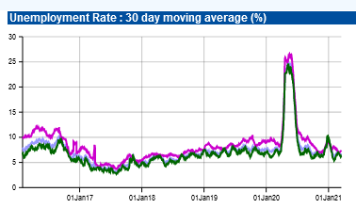
India's unemployment rate (UER) for the month of November 2020 stood at 6.51%, the lowest since September 2018 when it was 6.47%
According to the Centre for Monitoring Indian Economy (CMIE) data. While the urban unemployment rate stood at 7.07%, rural UER was 6.26%.

Slide 5
Scope
Aim:-
Skill Bridge
Freelancer:
Increase of employment amongst the Freelancers
Organization:
Project-Oriented Employee

Slide 6

Toptal

Slide 7

Upwork

Slide 8

Freelancer.com

Slide 9
How HYRE is Atypical?
Bidding is not an option
Strong Profile with better reach
Ranking
Skills Play a significant role

Slide 10
Literature Survey
Interactions with the freelancers
Concept which has maximum reach
Makes the system more efficient without bidding process
Availability of small projects to support amateur freelancers
Hiring process to be added as an advantage for the freelancers and project owners

Slide 11
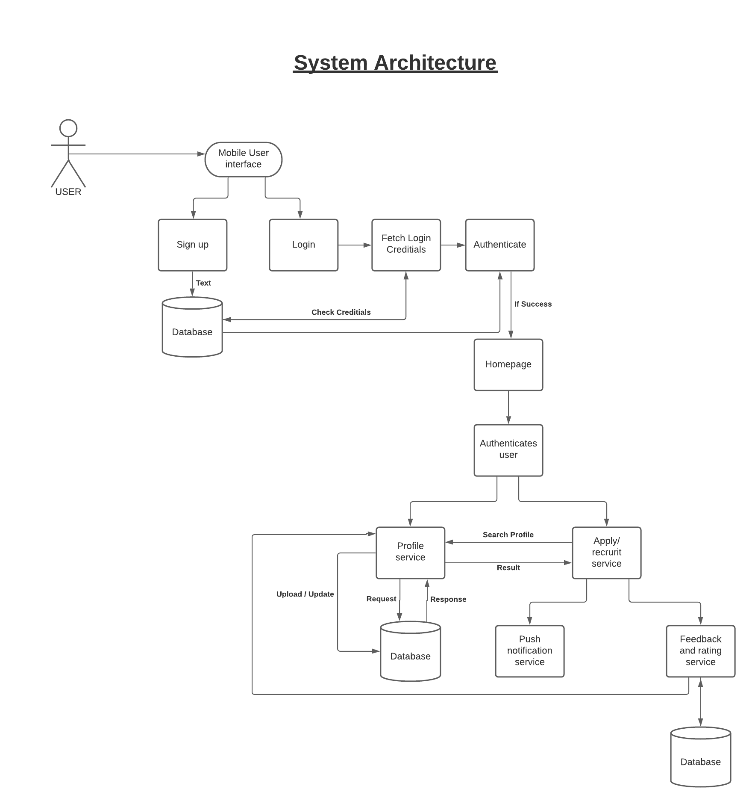
HYRE System Architecture

Slide 12
Modules
Login – It is a set of credentials used to authenticate a user.
Sign up – It is a phrase where we define our credentials to set up an online account.
Homepage - It is the first page of the interface whenever user login with their credentials.
Database – It is a collection of user’s data.

Slide 13
Modules
Profile service – A section where it represents the digital representation of one’s identity.
New Project - This allows the company to add new projects.
Push Notification service – User’s get notified through notification when a user apply or recruit.
Feedback and Rating service – This service is provided by Project Owner and it is a representation of freelancer work.

Slide 14
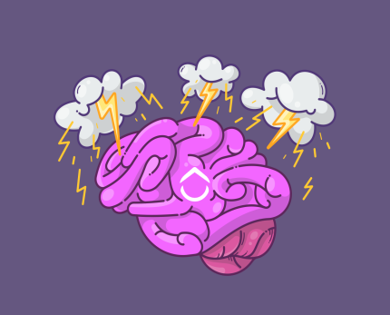


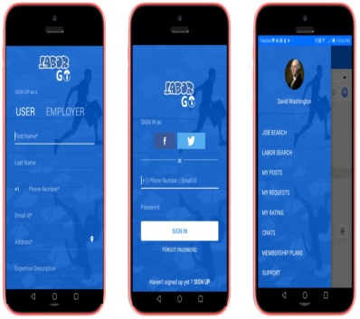

PLANNING
DEPLOYMENT

BRAINSTORMING

WIREFRAME

WORKING

DEVELOPMENT


Slide 15
References
U.YelizEseryel, DenizEseryel, Richard Hendrik Booji, Social Media Use for Online Interaction: Lessons Learned from Fortune 100 Companies on Job Applicant Attraction, 1st ed, NC,USA,2020
. Top 25 Freelance Websites to Find Work in 2021 (dynomapper.com)

Slide 16


